Slide 1
Classifying Bird Species in Singapore CE7454 Project
Group 14
Davide Coppola
Mitra Tajrobehkar
Shuang Wu

Slide 2
Motivation
Over 400 species on the island
Easy to spot a bird and take a picture, harder to recognize the species
Possible starting point for a future application

Slide 3


Data Acquisition
Website for enthusiasts
Almost guaranteed label accuracy
Development of web scraper from scratch
Well-know photo hosting website
More uncertainty on the labels
Combination of Flickr API and image downloader found on a Git project
Queries using scientific name to increase chance of correct label
Tools: Python3, Requests, BeautifulSoup

Slide 4
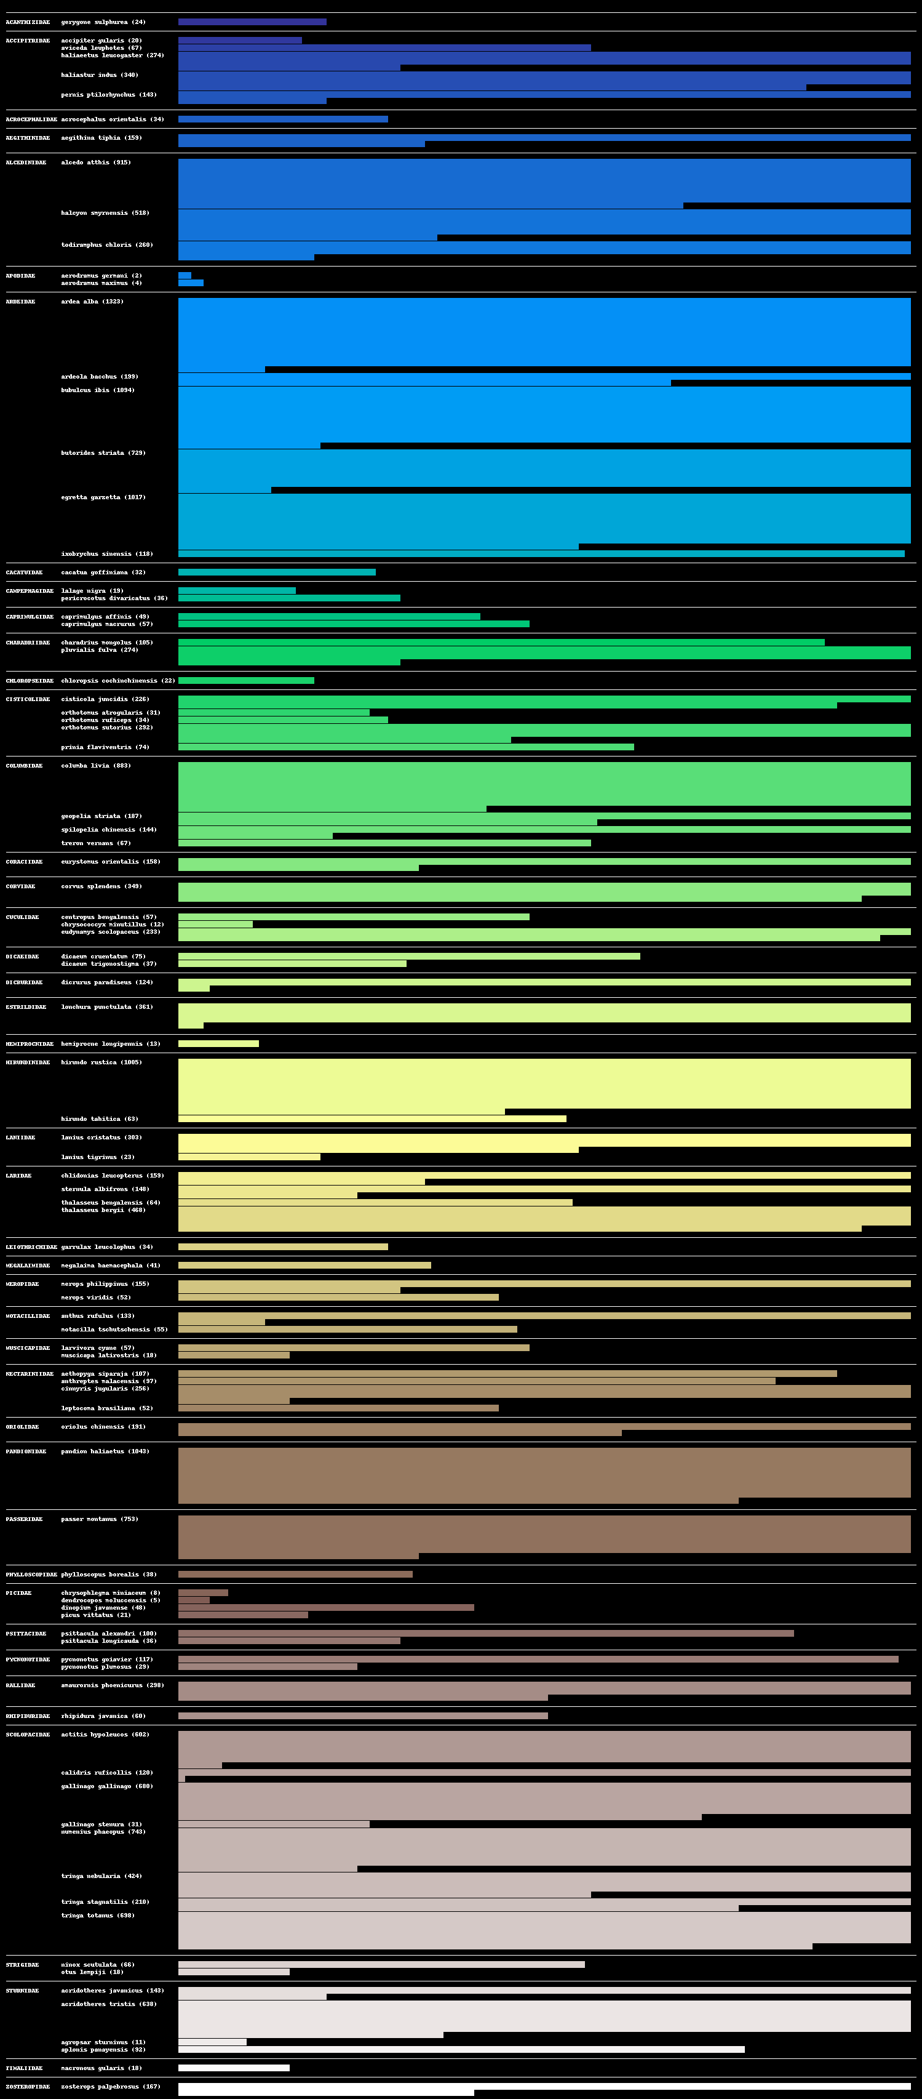
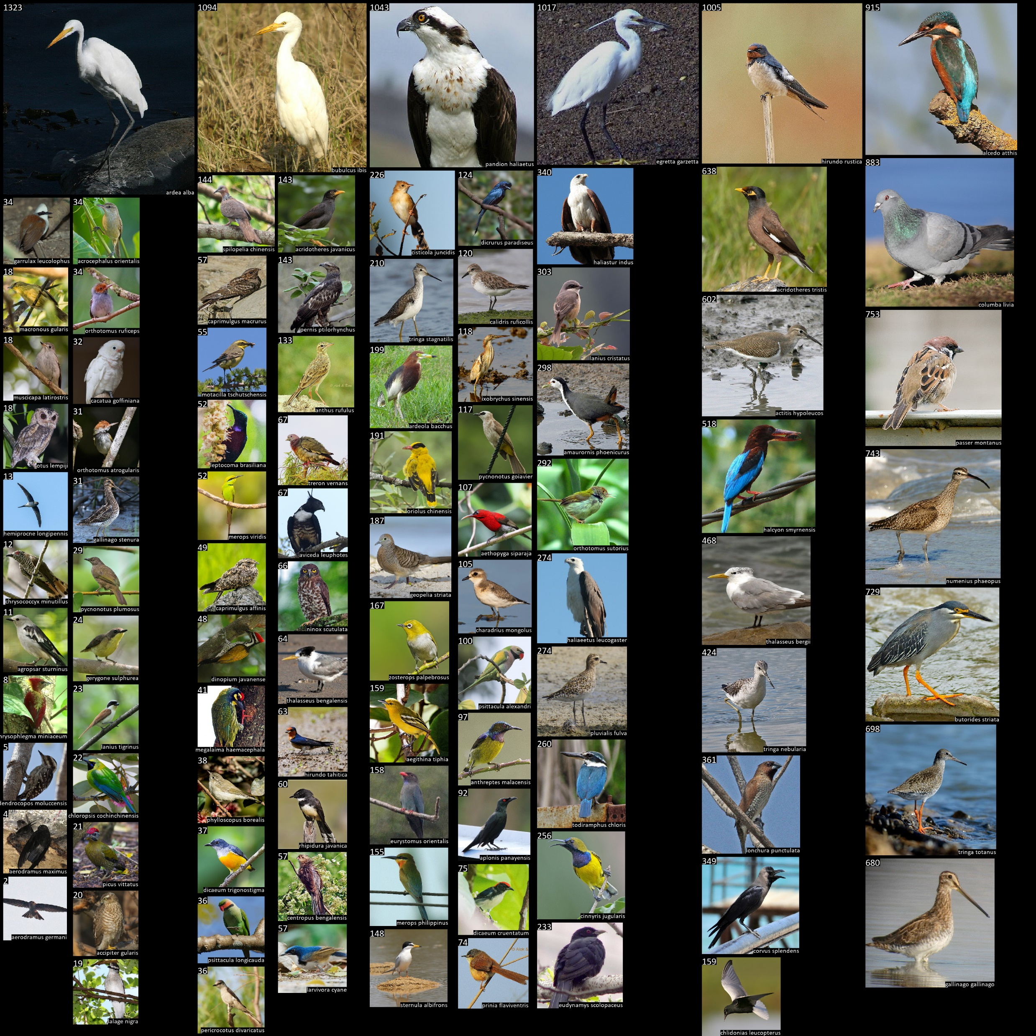
Data Visualization

Slide 5
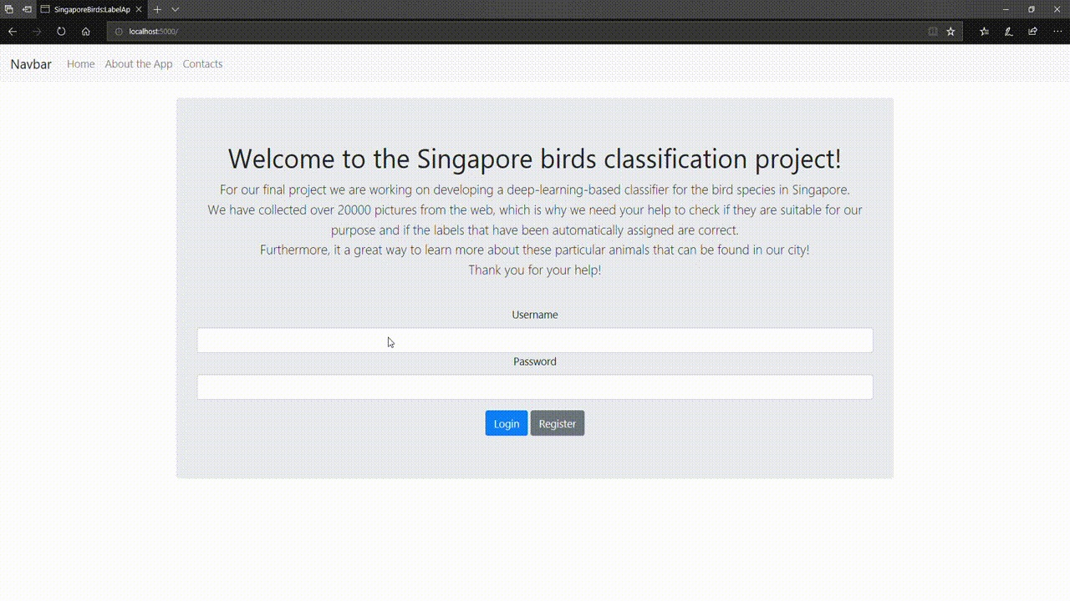
Data Validation

Slide 6
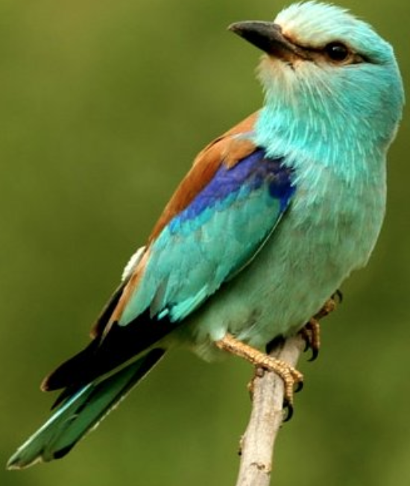
Classification
✔
# Family
Accipitradiae
Ardeidae
Laniidae
Corvidae
…
# Species
butorides striata
garrulax leucolophus
…
✔

Slide 7
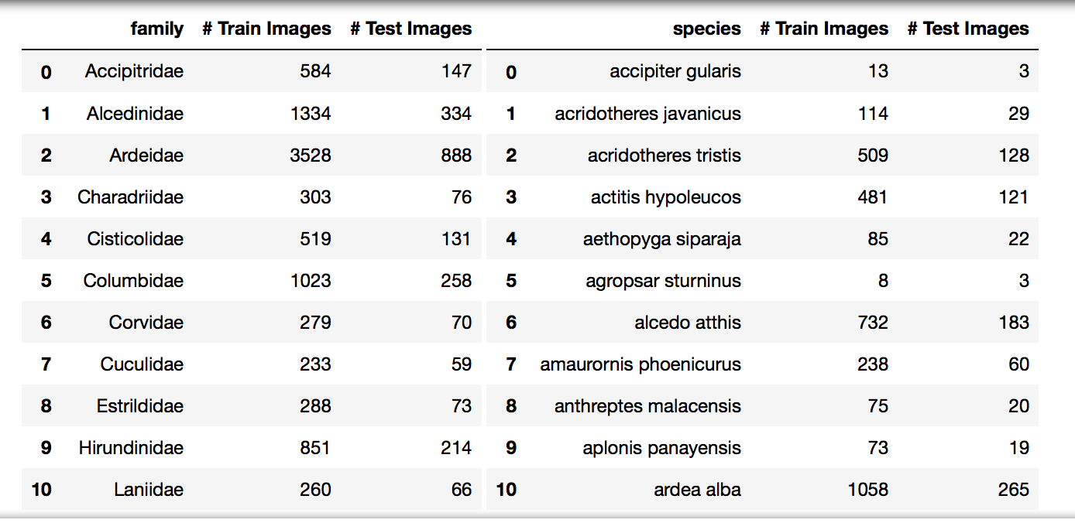
Experiment Setup

Slide 8
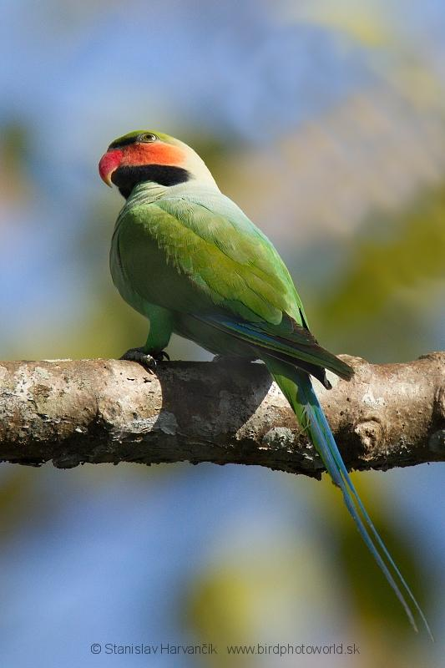
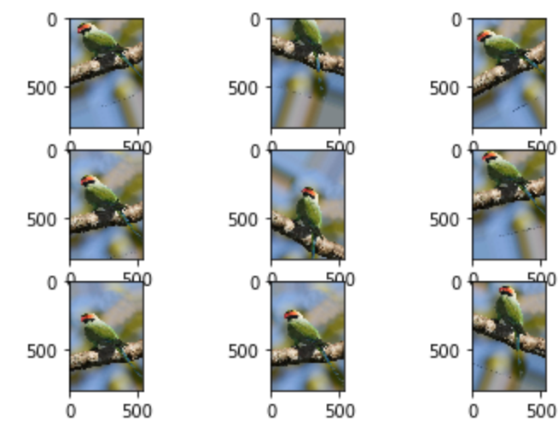
Data Preprocessing and Augmentation
Generate custom augmented images using Adaptive Histogram Equalization

Slide 9
Classification- Proposed method
Feature extraction
Resnet50
VGG16
Loss function
Softmax cross entropy loss
Triplet loss

Slide 10
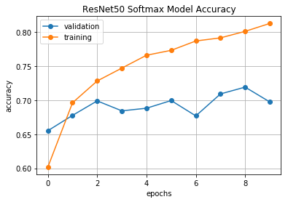
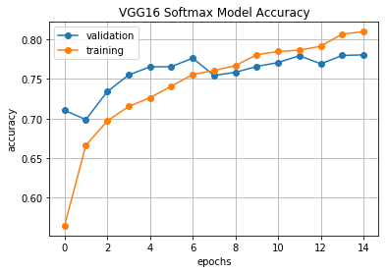
Comparison of two models- Training
ResNet50 softmax model accuracy
VGG16 softmax model accuracy
Architecture | Training Acc. | Training loss | Validation Acc. | Validation loss
ResNet50 | 0.81 | 0.59 | 0.70 | 1.24
VGG 16 | 0.81 | 0.60 | 0.78 | 0.94

Slide 11
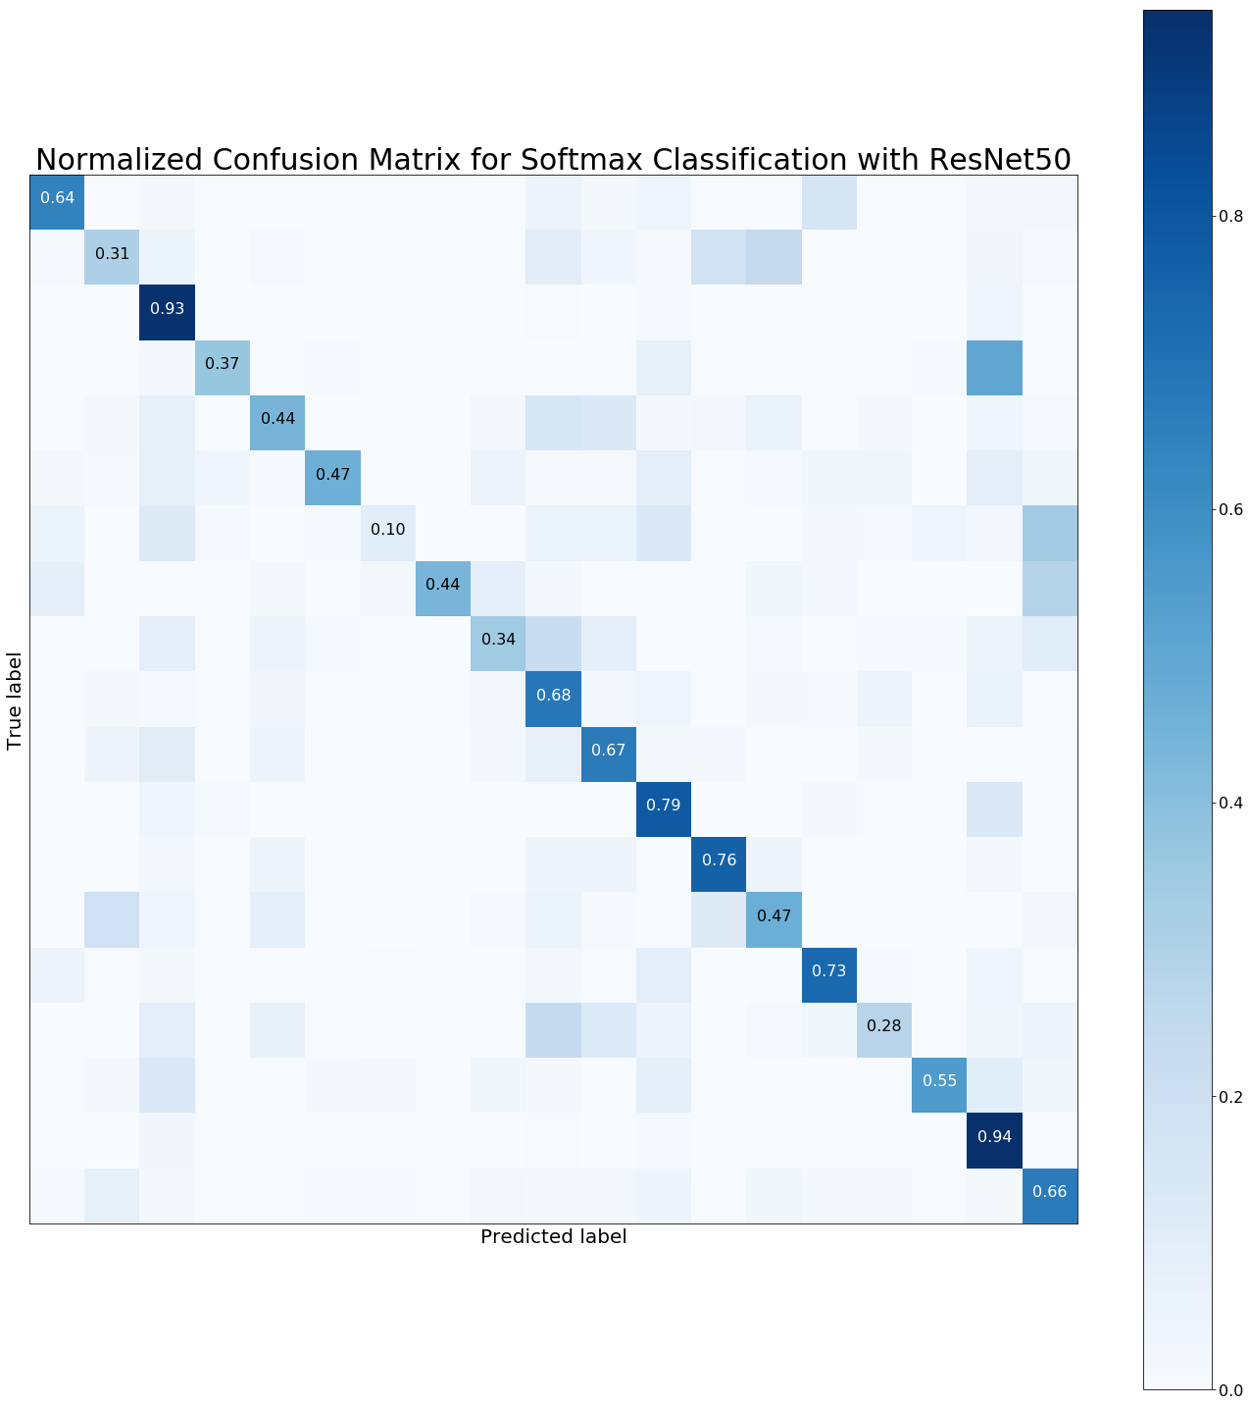
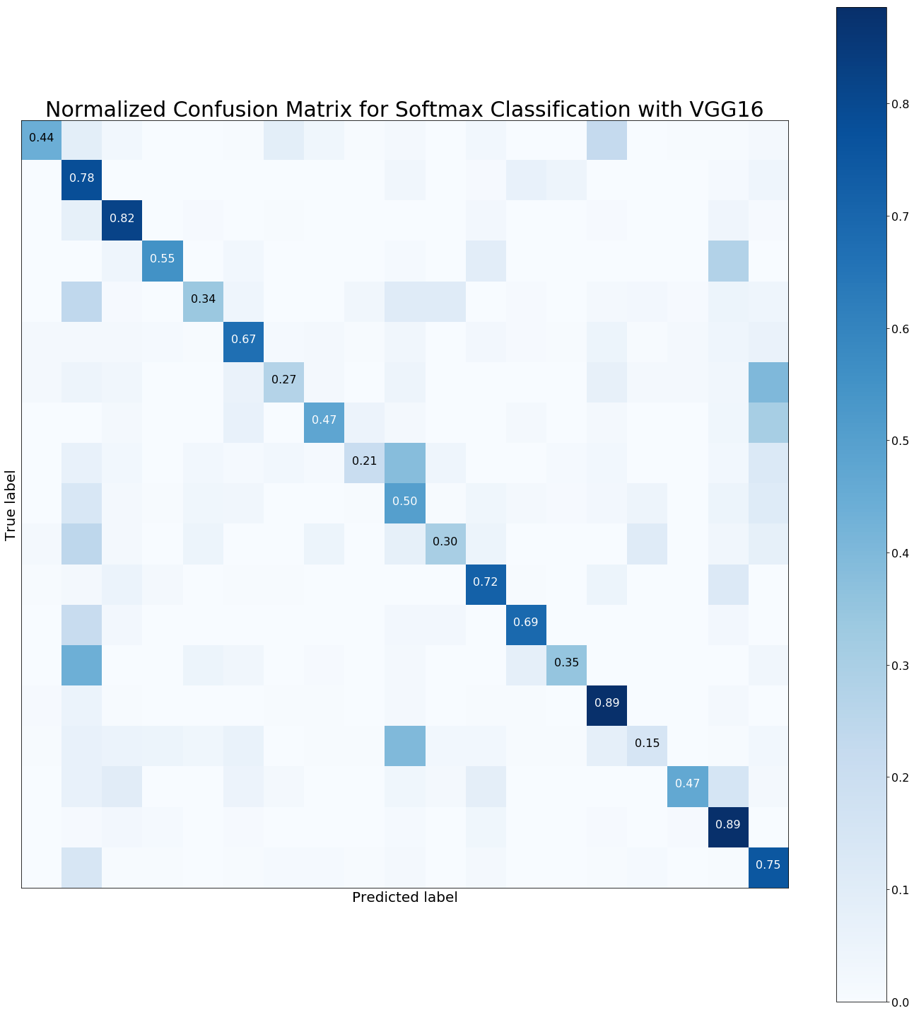

Slide 12
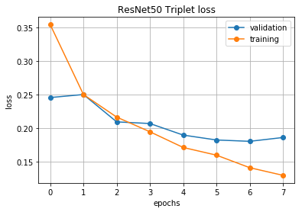
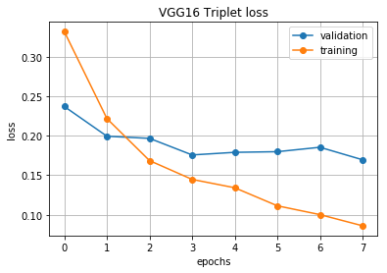

Slide 13
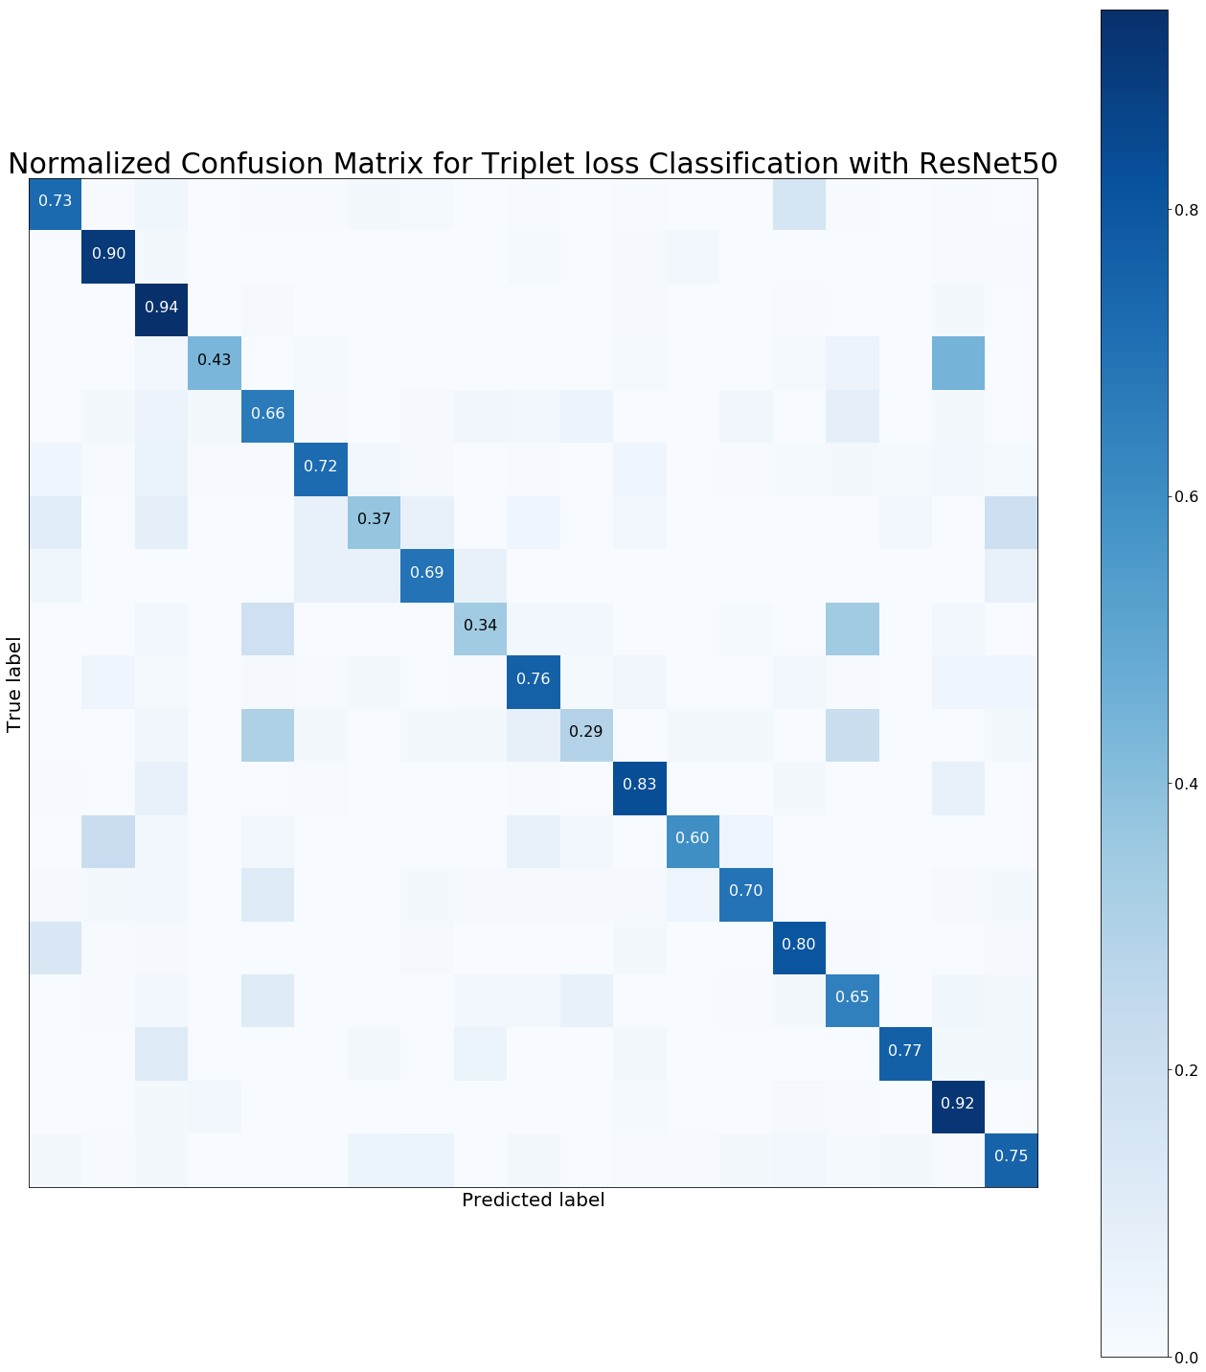
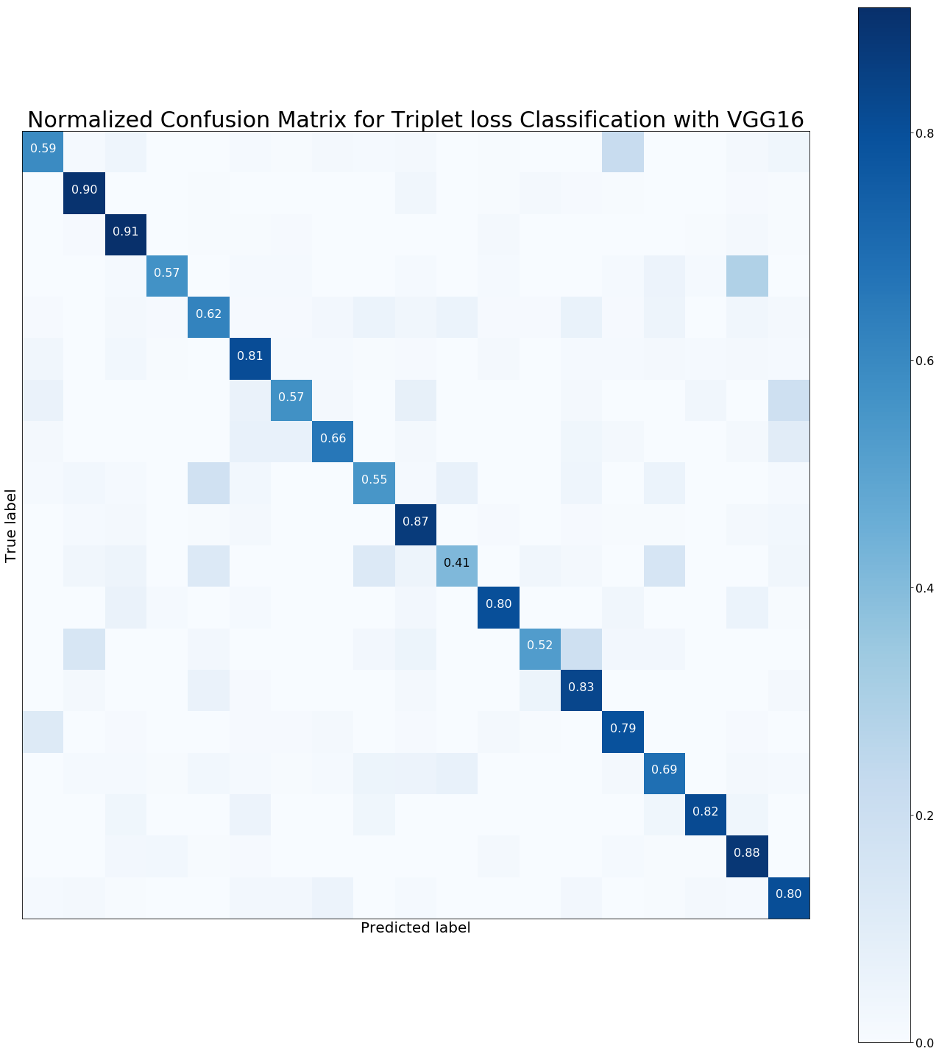

Slide 14
Triplet Loss

Slide 15
Github!
MitraTj/ntu_CE7454_ClassifyingBirdSpecies

